Slide 1

Optimizing Color Consistency in Photo Collections
By team thankyoudoctor

Slide 2
AIM
To ensure a consistent appearance of connected photos without user explicitly making changes to every single photo.

Slide 3
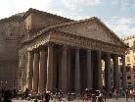
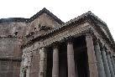
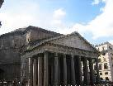
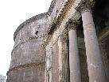
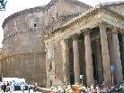
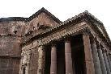
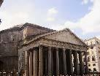
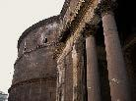
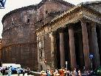
AIM
Input Images
Output Images

Slide 4
Causes for inconsistencies
Changes in Lighting Conditions.
Changes in Camera Settings.
Changes due to different Cameras altogether.

Slide 5
Constraints
In the process of imposing color consistency, we attempt to balance between achieving color consistency and preserving the dynamic range and natural appearance of individual photos.

Slide 6
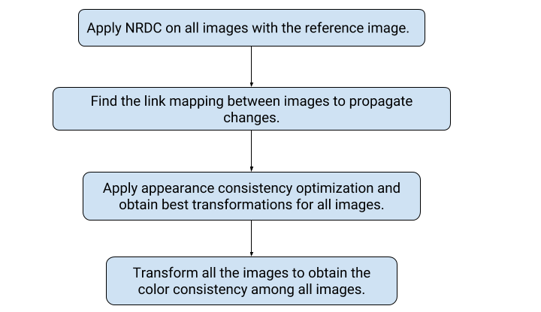
Workflow

Slide 7
APPROACH:
Histogram Matching in different colour spaces

Slide 8




Histogram Matching
Top Left: Source
Top Right: Reference
Bottom Left: Image obtained after histogram matching of source image with that of reference in RGB colour space
Bottom Right: Image obtained after histogram matching of source image with that of reference in HSI colour space

Slide 9
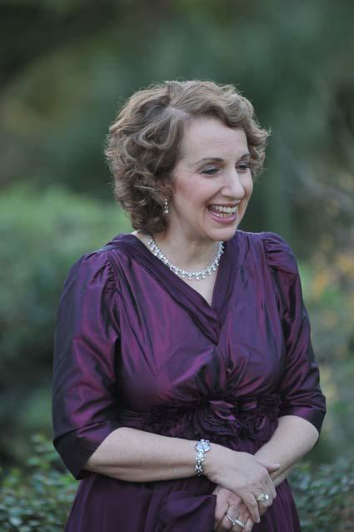

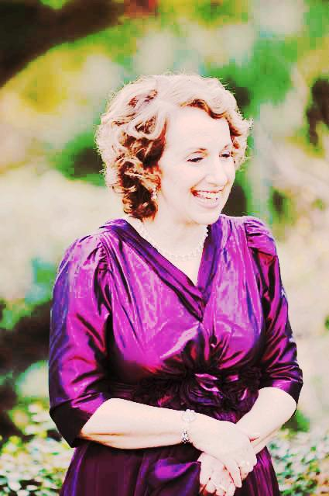
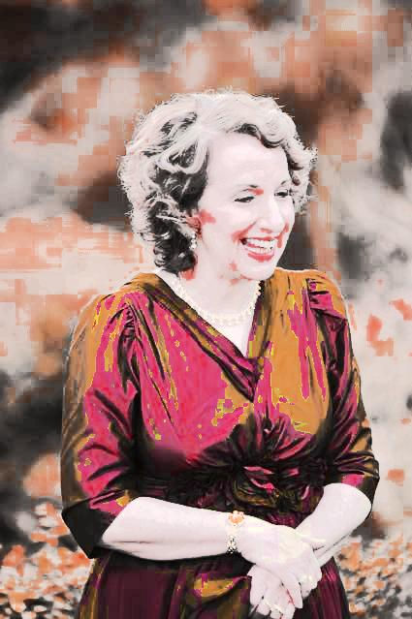
Histogram Matching
First: Source Second: Reference Third: Image obtained after histogram matching of source image with that of reference in RGB colour space Fourth: Image obtained after histogram matching of source image with that of reference in HSI colour space

Slide 10
Histogram Matching
Doesn’t work well when the images are less similar like in the previous example the backgrounds are different in the source and the reference image.
Thus, we need to do first need to find the correspondences between images and find a transformation model that can effectively convert the source image.

Slide 11
APPROACH:
Finding correspondences using SIFT

Slide 12
Colour consistency using SIFT
Find correspondences between source and reference images using SIFT.
Fit four colour transformation curves R, G, B and saturation for the corresponding regions from source to reference images.
Apply the colour transformation globally (to complete image).

Slide 13
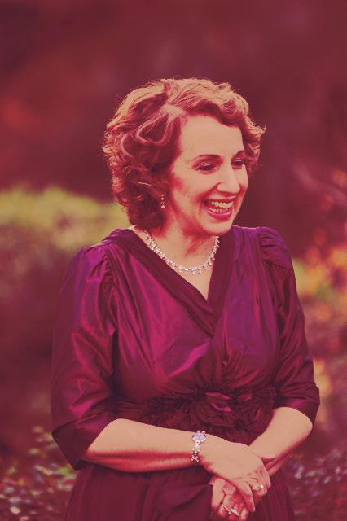
Colour consistency using SIFT
Left: Source image Middle: Reference image Right: Image obtained after applying the previous steps

Slide 14
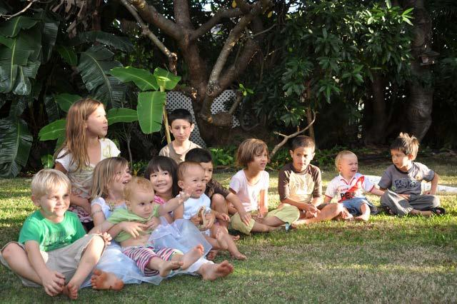
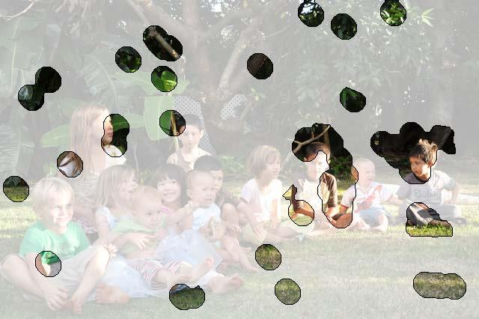
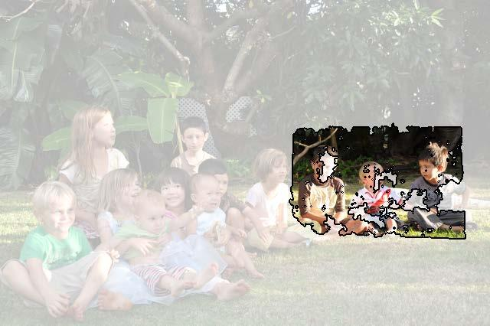
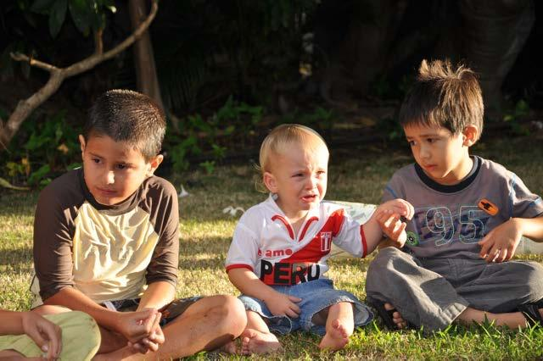
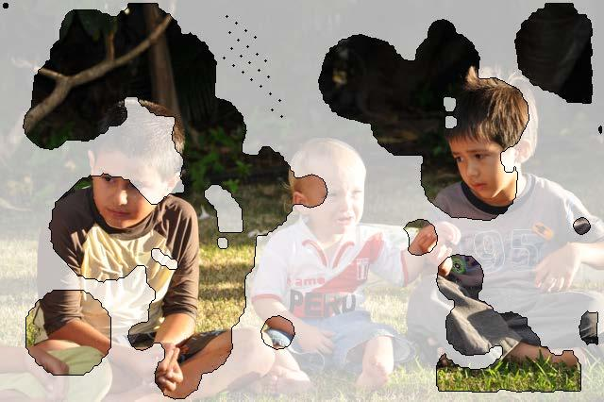
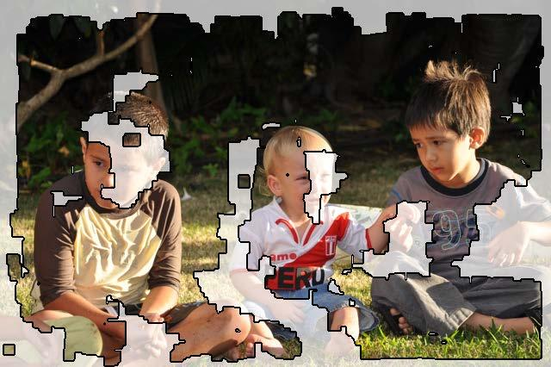
Colour consistency using SIFT
SIFT feature are very sparse and contain error while creating the consistent regions
Source and Reference (First Column), Consistent Regions in Source and Reference and using SIFT (Second Column) and Consistent Regions in Source and Reference and using NRDC (Third Column)

Slide 15
APPROACH:
Finding correspondences using NRDC

Slide 16
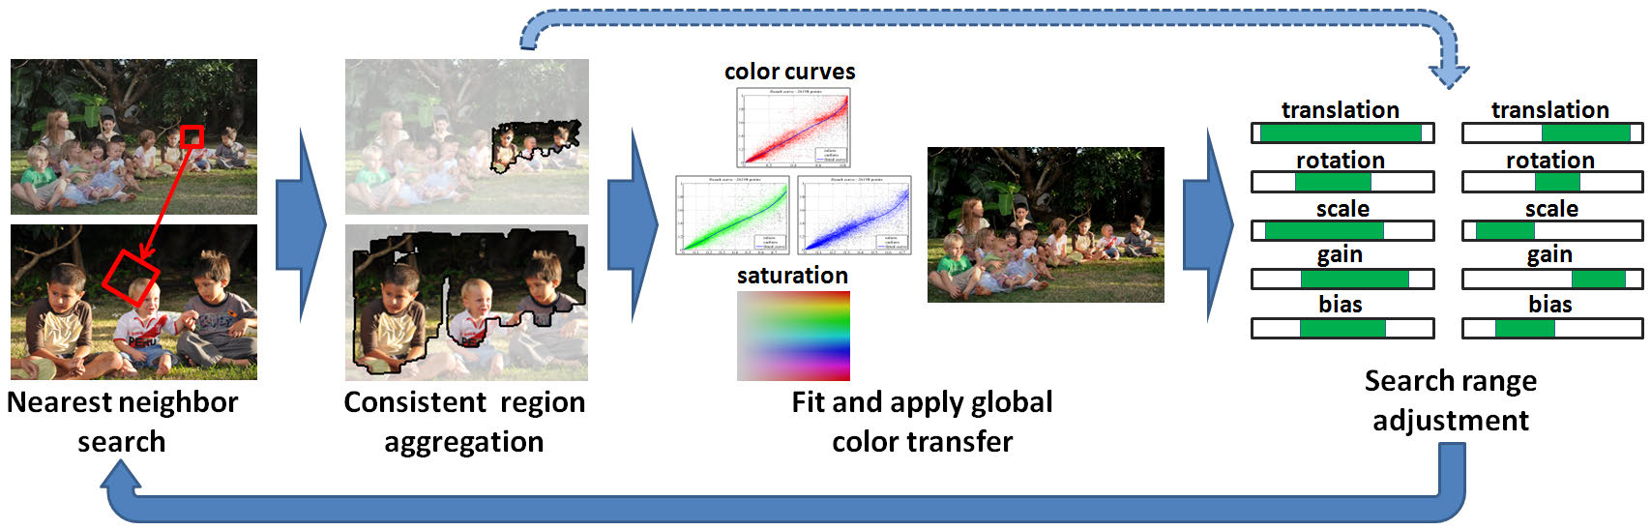
Non-Rigid Dense Correspondence (NRDC)

Slide 17
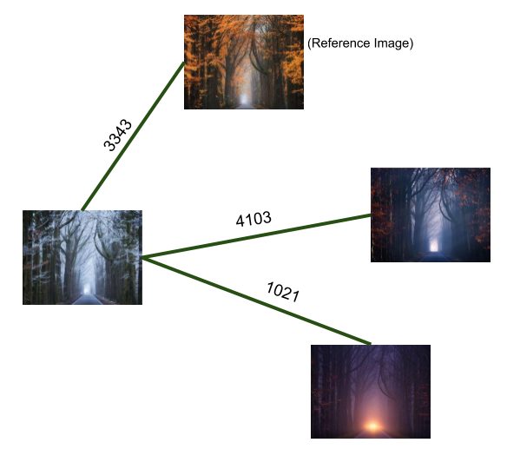
Match Graph
Vertices are images
Edges contain information regarding the correspondences between photo pairs

Slide 18
Appearance Consistency Optimization

Slide 19
Appearance Consistency Optimization
Ensuring that pixels depicting the same content have the same color across different images.
Avoiding​ unsightly​ visual​​ artifacts, ​such​​ as​ gradient reversals​​ or​​ severe​​ loss​​ of​​ contrast.
Attempting​ to ​preserve​​ as​ ​much​ as​​ possible​ ​the​ ​original dynamic​ range​​ of​​ each​​ photo.

Slide 20
Color Transform
Model
The model fits three monotonic curves, one per channel of the RGB color space
Each curve is a smooth piecewise-quadratic spline with 7 knots at (0, 0.2, 0.4, 0.6, 0.8, 1)
an expressive global parametric model for transformation of each image

Slide 21
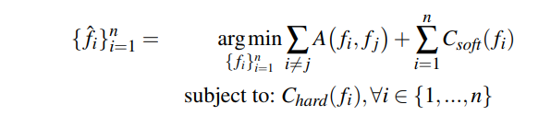
Color Transform Model
For every pair of images vi ,vj ∈ G(V) we would like to find a transformations fi , fj such that we can minimize A(fi , f j) for the entire graph.

Slide 22
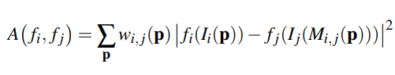
Affinity Term A(f​i ,fj​):​
The pairwise affinity term A(f i ,f j ) is defined using the weighted SSD (sum of squared differences) between color-mapped pairs of matching pixels.

Slide 23
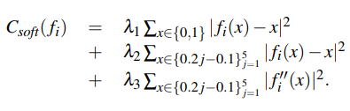
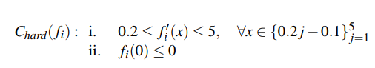
Regularization
The shape of each curve is regularized via unary soft constraint term
λ1 and λ2 together try to pull the curve towards identity mapping
λ3 controls the smoothness of the curve by penalizing large deviations in the second derivative
λ1 preserves the dynamic range and λ2 to control preservation of original appearance
The curve is forced to be strictly monotonic and to cross the x axis right of the origin

Slide 24
RESULTS

Slide 25
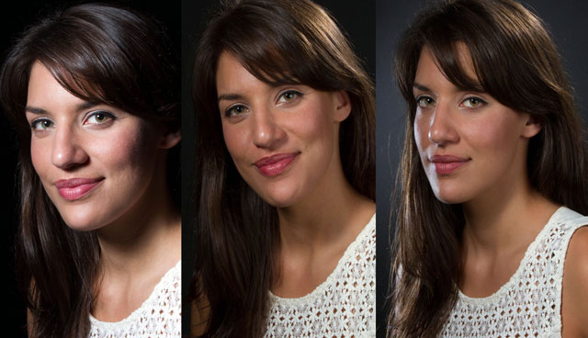
Input
Source

Slide 26
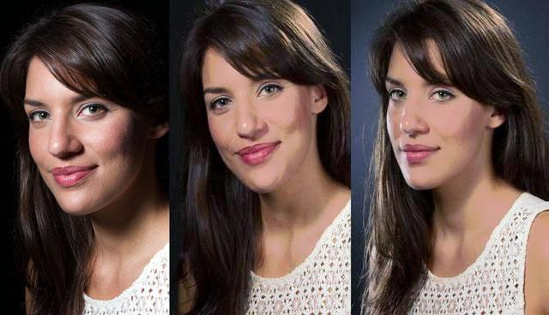
Output
Source

Slide 27
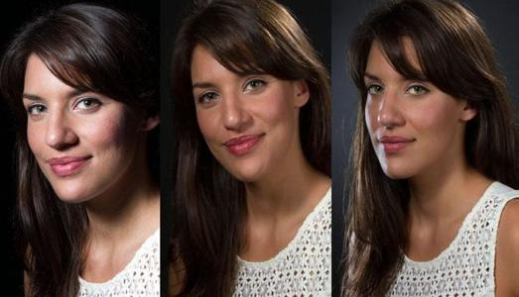
Input
Source

Slide 28
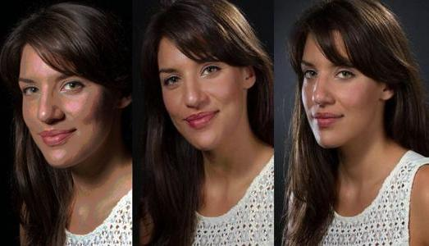
Output
Source

Slide 29
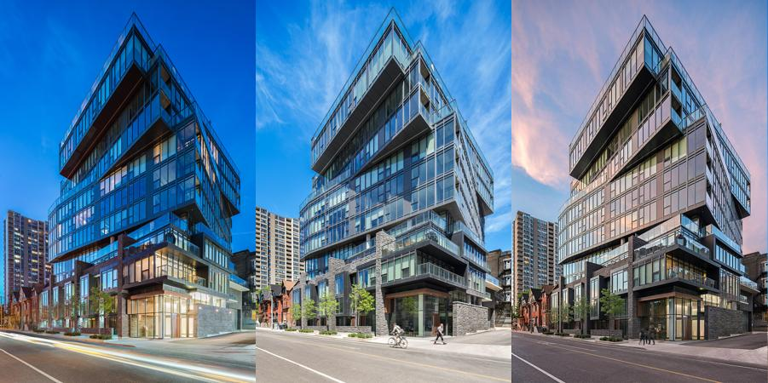
Input
Source

Slide 30
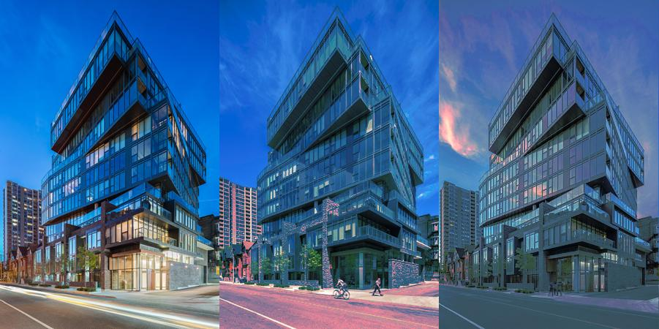
Output
Source

Slide 31
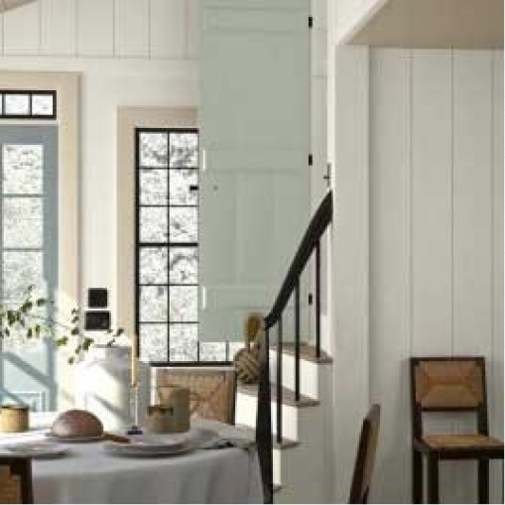
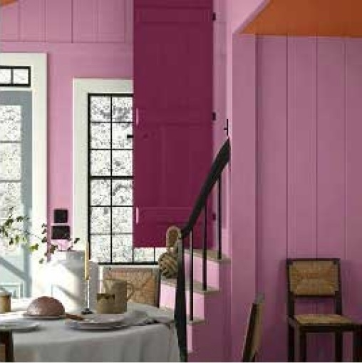
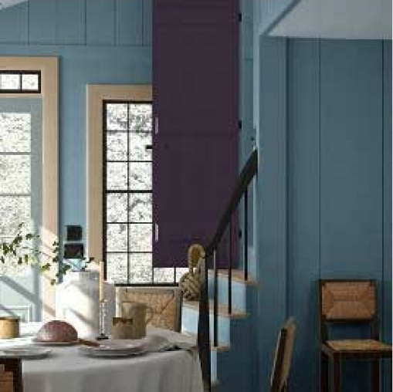
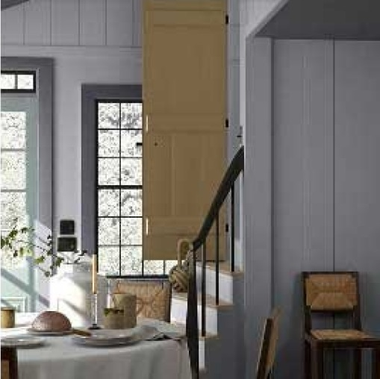
Input
Source

Slide 32
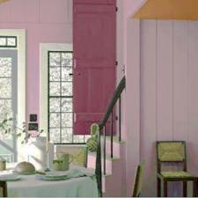
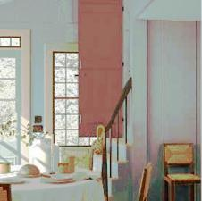
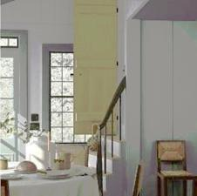
Output
Source

Slide 33

Input
Source

Slide 34

Output
Source

Slide 35
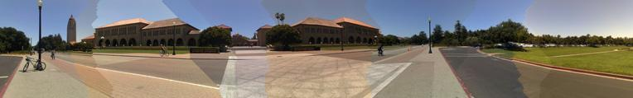
Application in Panorama Stitching
Panoramic Stitching without colour correction

Slide 36
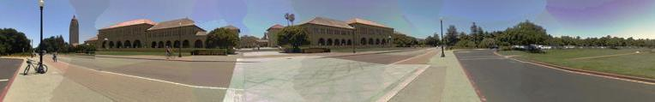
Application in Panorama Stitching
Panoramic Stitching after colour correction

Slide 37
Application in Panorama Stitching
Panoramic Stitching without colour correction

Slide 38
Application in Panorama Stitching
Panoramic Stitching after colour correction

Slide 39
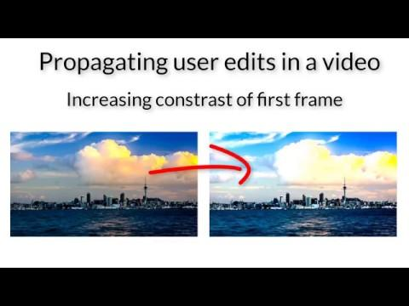

Slide 40
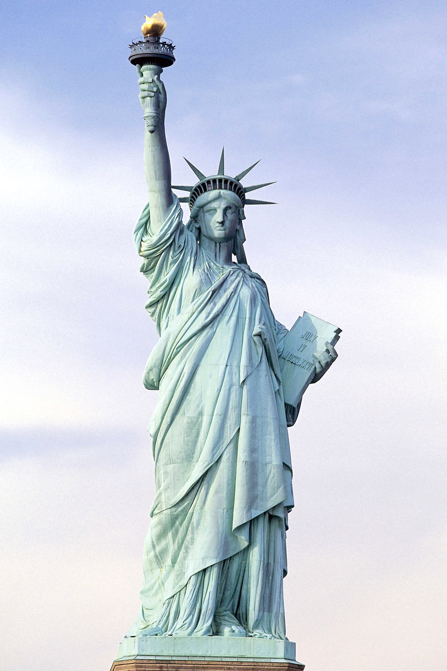
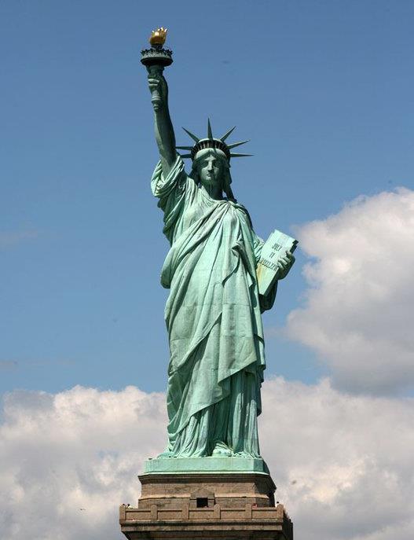
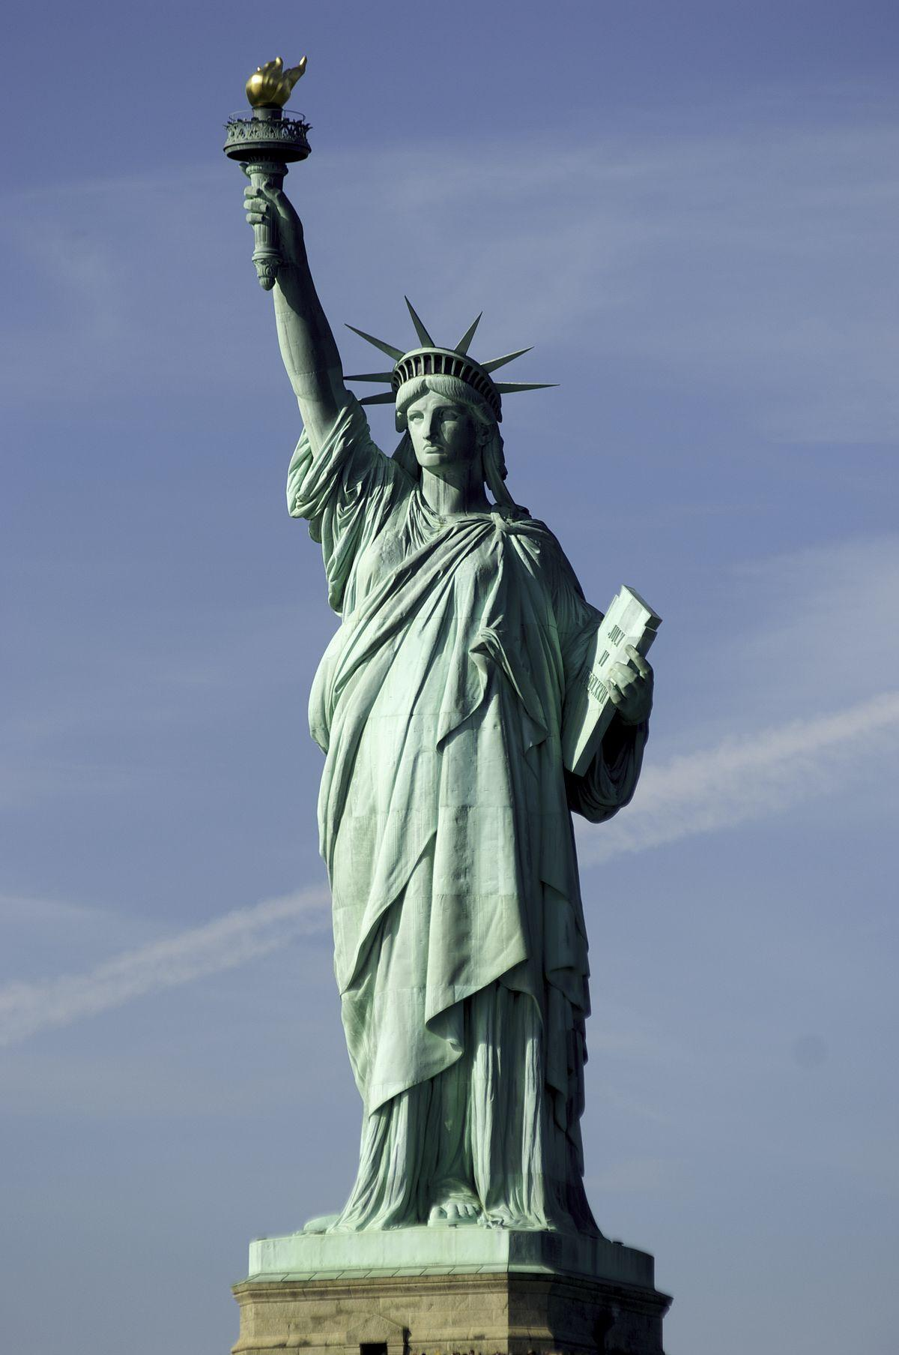
Failure Cases (Input)
Source

Slide 41
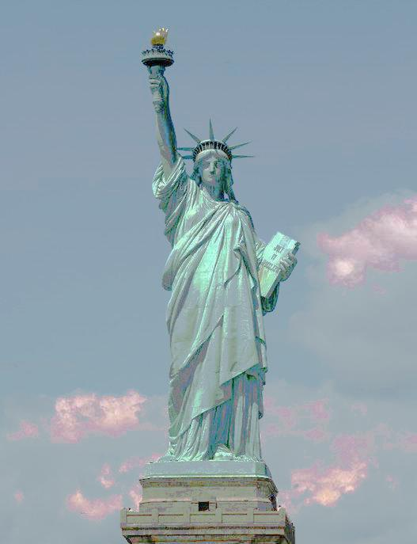
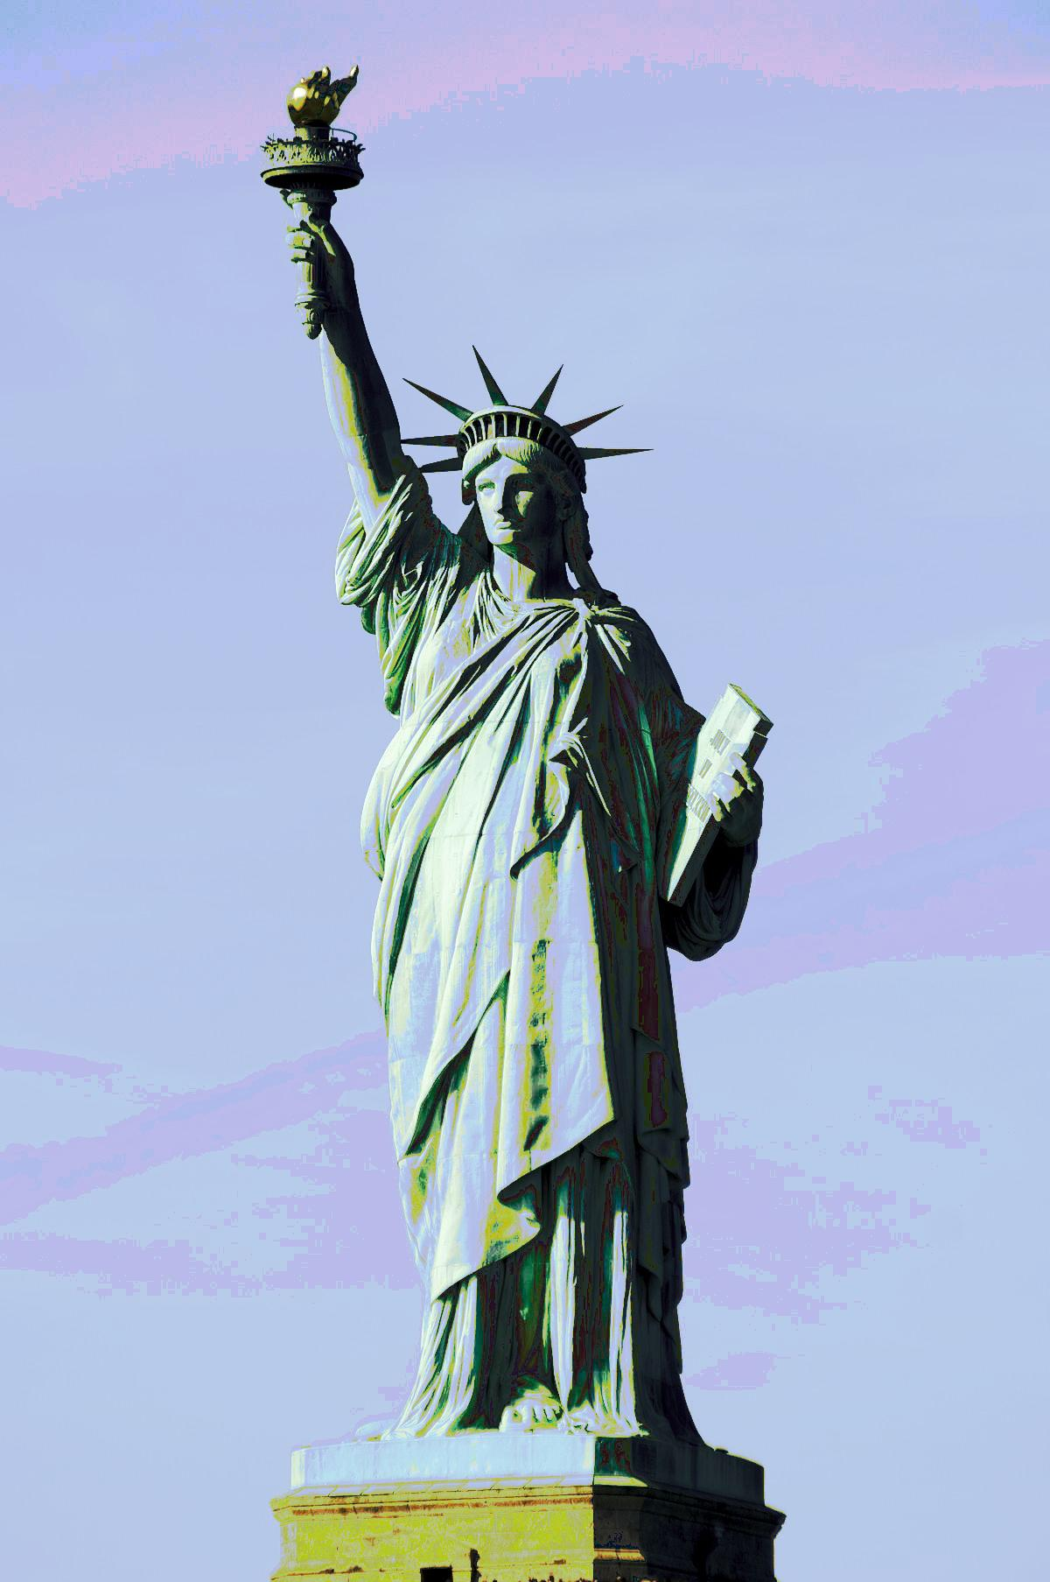
Failure Cases (Input)
Source

Slide 42
Discussion and analysis
NRDC is a state of the art method the find correspondences for non rigidly objects but NRDC has difficulty in finding reliable correspondences in very large smooth regions, such as clear sky in the above case.
The global parametric color model is robust to errors in correspondence and is easier to regularize. Hence this model is used over a localized model.
The time for making the dense graphs and its further propagation is time consuming, hence, we need an even better mechanism to predict the links and propagate

Slide 43
Conclusion
A ​consistent​ ​appearance​ ​of​ ​connected​ ​photos without​ ​user​ explicitly​ doing​ ​it​ on​ ​every​ single​​ photo
Propagate changes made by user from an image to the collection of images.

Slide 44
Thank you
Any questions?

